Slide 1

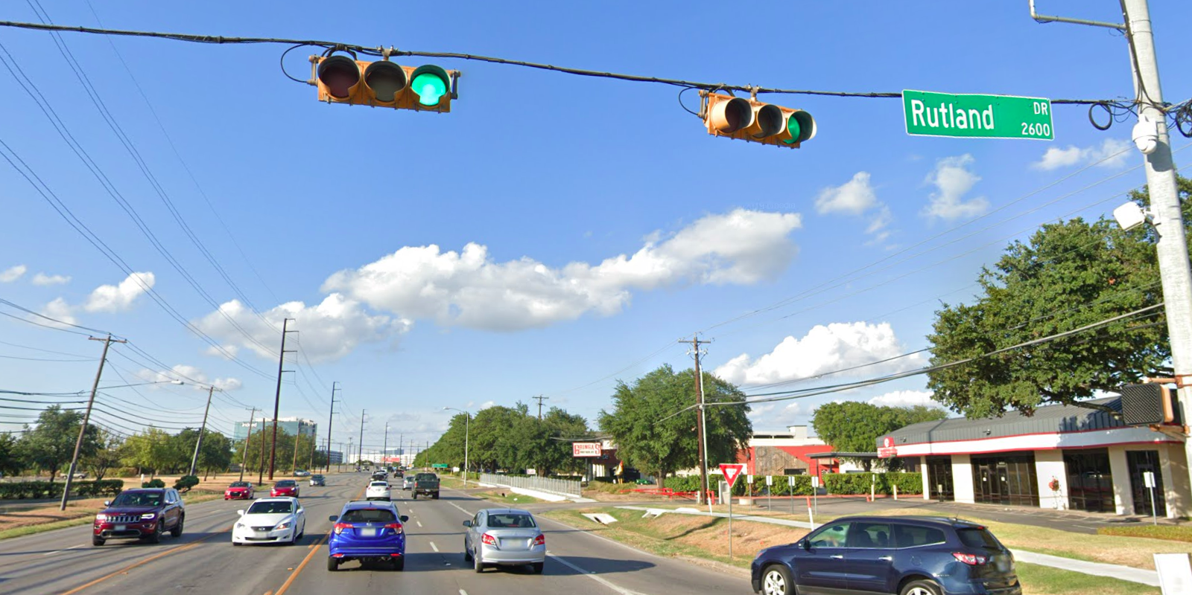
Austin Transportation Department Signs Work Orders
Created By: Susanne Gov Created Date: 2020-08-10 Location Name: BURNET RD / RUTLAND DR Intersection ID: 5159209 Cardinal Direction: N Work Order ID: SG-20461
Sign Type | Install/Remove
Street Name Sign | Install

Slide 2
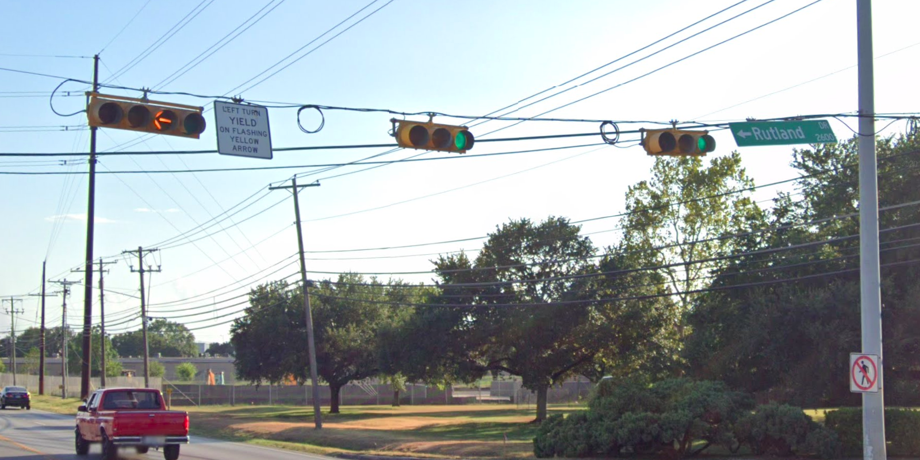
Austin Transportation Department Signs Work Orders
Created By: Susanne Gov Created Date: 2020-08-10 Location Name: BURNET RD / RUTLAND DR Intersection ID: 5159209 Cardinal Direction: S Work Order ID: SG-20461
Sign Type | Install/Remove
Left Turn Yield Flashing Yellow | Remove
Street Name Sign | Install

Slide 3
Austin Transportation Department Signs Work Orders
Created By: Susanne Gov Created Date: 2020-08-10 Location Name: BURNET RD / RUTLAND DR Intersection ID: 5159209 Cardinal Direction: E Work Order ID: SG-20461
Sign Type | Install/Remove

Slide 4
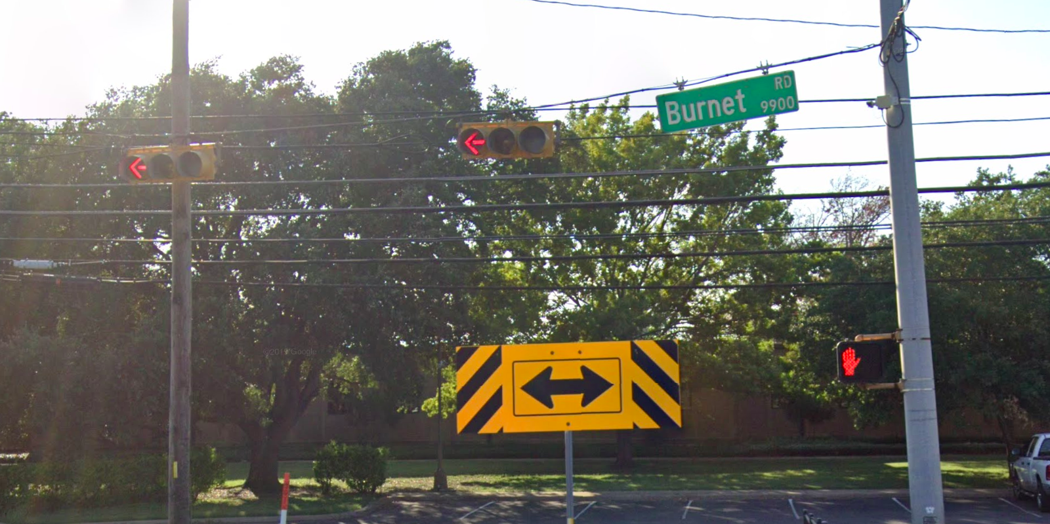
Austin Transportation Department Signs Work Orders
Created By: Susanne Gov Created Date: 2020-08-10 Location Name: BURNET RD / RUTLAND DR Intersection ID: 5159209 Cardinal Direction: W Work Order ID: SG-20461
Sign Type | Install/Remove
Street Name Sign | Install

